Slide 1
Cloud Computing definition: the practice of using a network of remote servers hosted on the Internet to store, manage, and process data, rather than a local server or a personal computer.
By: JustiN Edens, Nick Passantino, Evan johnson

Slide 2


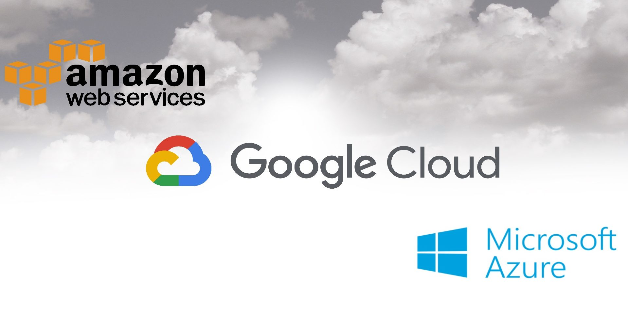
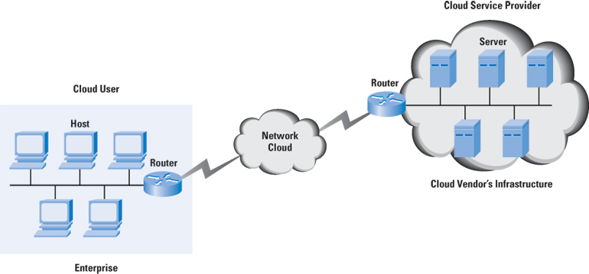
How Does Cloud Computing Work?
Cloud computing gives you access to servers, storage, databases, and a broad set of application services over the Internet. AWS(Amazon Web Services) and Google Cloud are examples of cloud service providers that own and maintain the network-connected hardware required for these application services, while you use what you need via a web application.

Slide 3
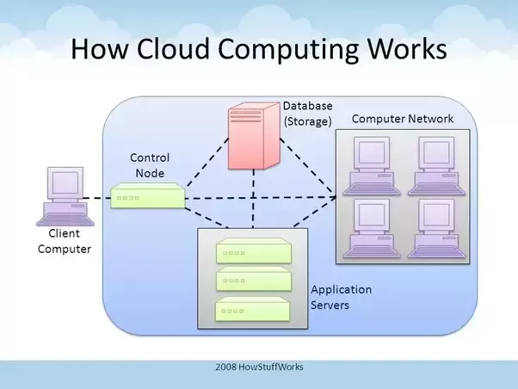
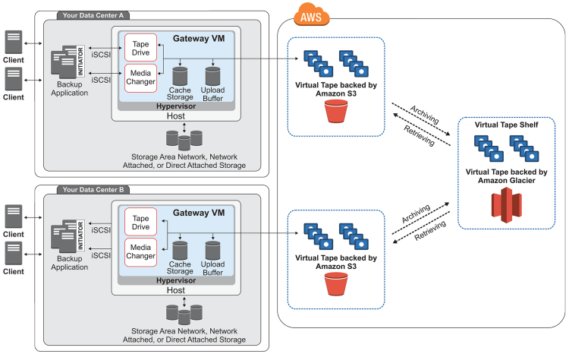
Simplified Perspective
FRONT END
Users connect through the internet via a local device
BACK END
A central server acts as a control and interprets actions working with a database, computer network, and servers

Slide 4
Back end breakdown
Central server
Follows rules called protocols
Uses middleware. This lets the networked computers communicate with each other
Computer Network
Can utilize the networks combined processing power to speed up operations

Slide 5
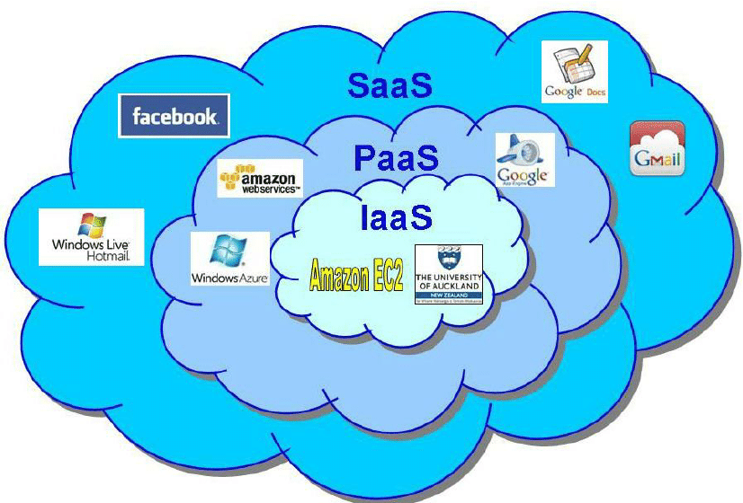
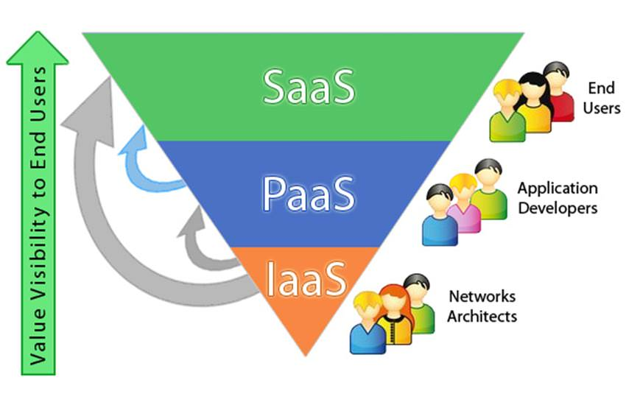
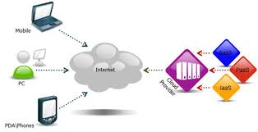
Cloud computing service models
IaaS (Infrastructure as a Service)
(HOST) consumer is able to deploy and run software, including applications and operating systems.
PaaS (Platform as a Service)
(BUILD) consumer is able to deploy onto the cloud infrastructure consumer-created or acquired applications created using programming languages, libraries, services, and tools supported by the provider.
SaaS (Software as a Service)
(CONSUME) consumer is able to use the provider’s applications running on the cloud. The applications are accessible from various client devices through either a thin client interface, such as a web browser or a program interface.

Slide 6




Benefits of Cloud Computing
Speed
You don’t have to manage any physical servers
Cost efficiency
You only pay for the service and not the physical server
Elasticity
Being able to scale up or down at any point

Slide 7

Pros and cons
PROS:
Reduces IT cost
Increases processing power
Allows you to access files anywhere
Don’t need space for servers and hardware
CONS:
Must have internet
Security (the cloud can be hacked)
Privacy (handing your data to a third party)
Usage fees
Bandwidth capes

Slide 8
Fun fact
AWS is the cloud provider of many leading worldwide companies, including Netflix, Expedia, Spotify, and Ubisoft. In fact, AWS holds about 41.5 percent of all installed application workloads. As of 2017, its market share held in at approximately 47 percent, with a whopping Q4 revenue of $3.66 billion

Slide 9
Getting Started with GCP
A tutorial on setting up a GCP account

Slide 10
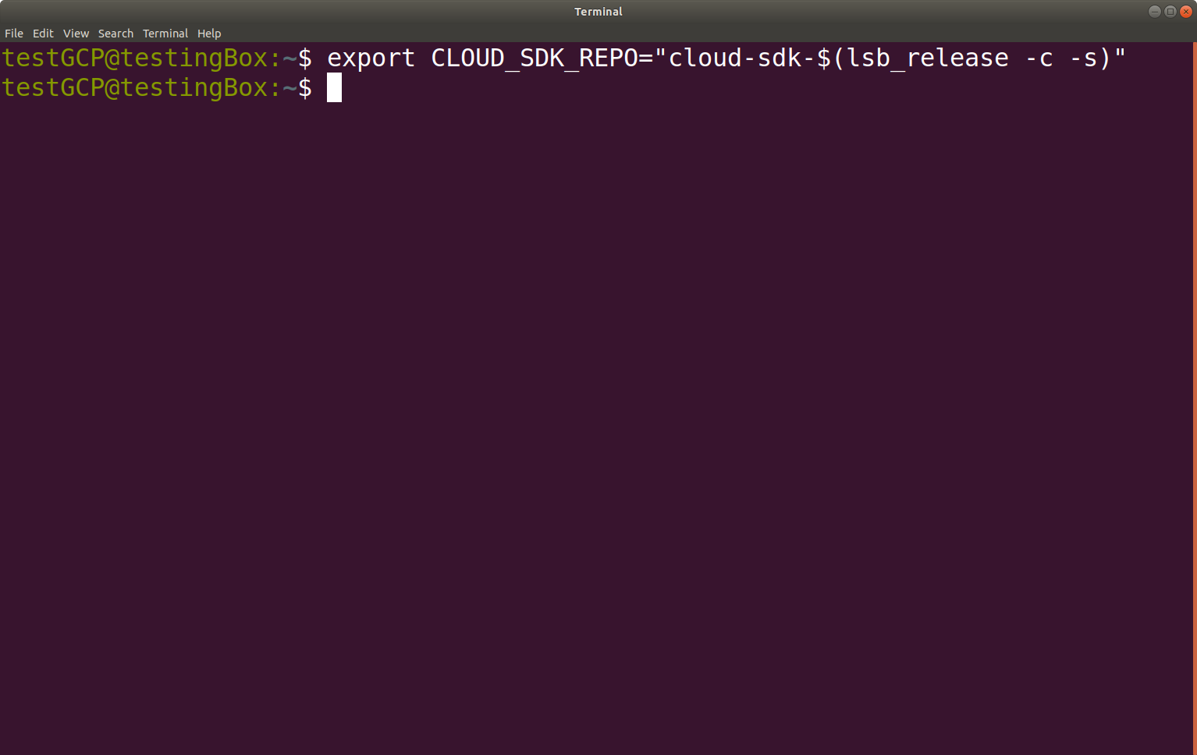
Create an environment variable to ensure the correct distribution is identified:

Slide 11
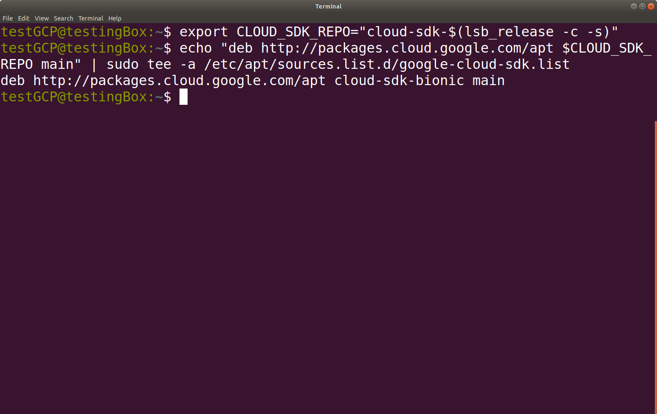
Add the Cloud SDK Distribution Cloud URI as a package resource

Slide 12
Add the Cloud SDK Distribution Cloud URI as a package resource

Slide 13
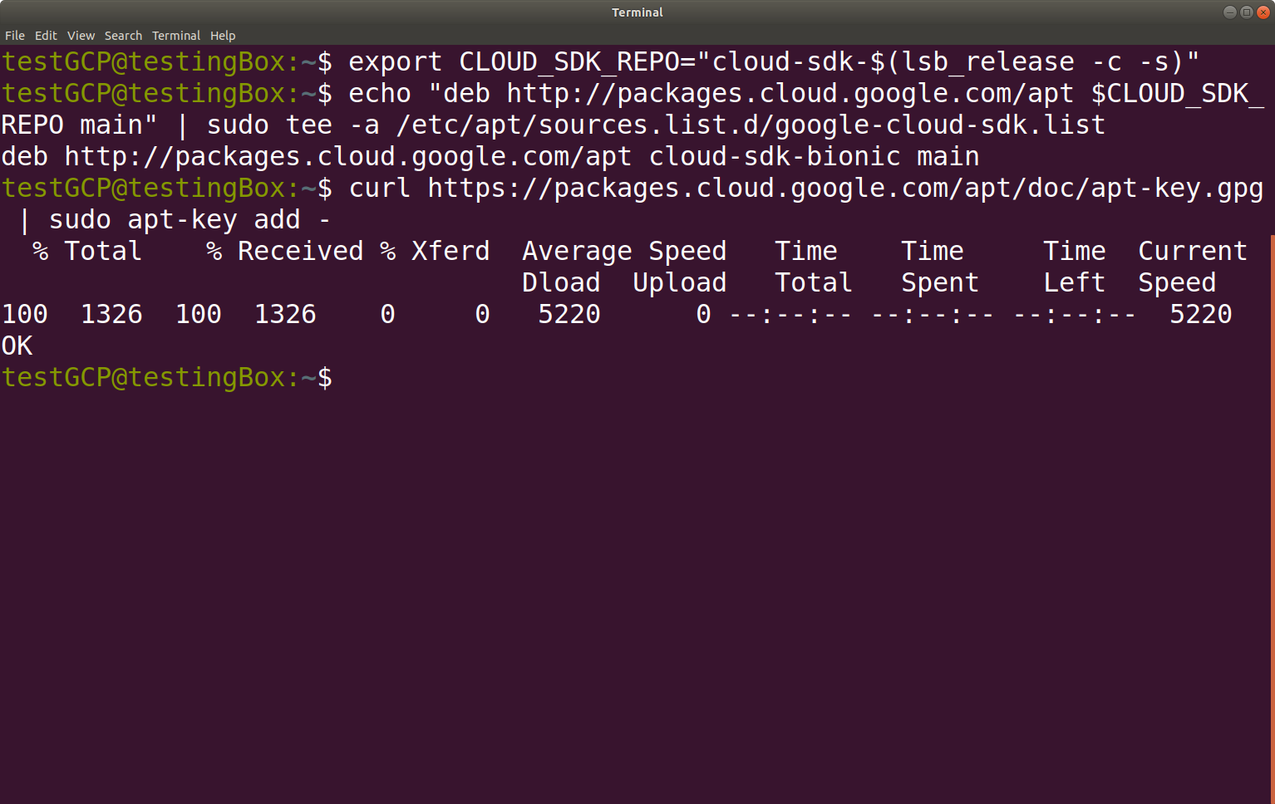
Import the Google Cloud Platform public key

Slide 14
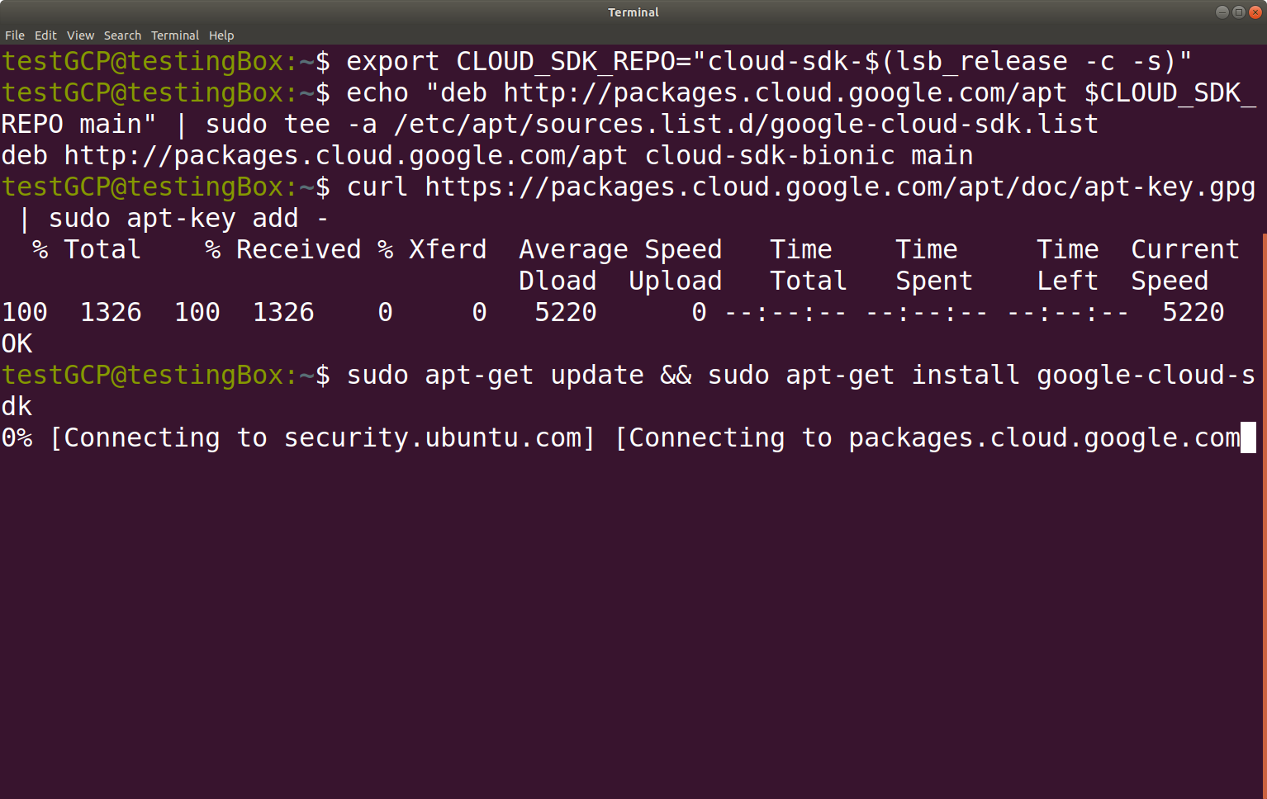
Update the package list and install the SDK

Slide 15
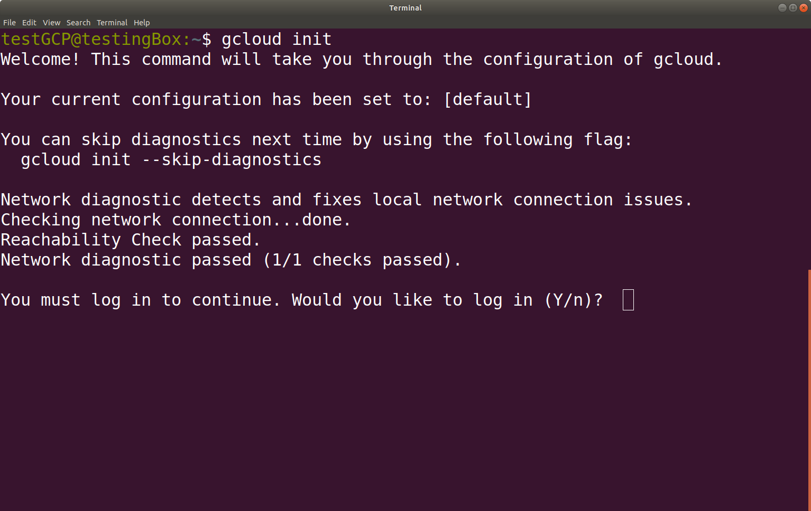
Now the GCP manager can be initialized

Slide 16
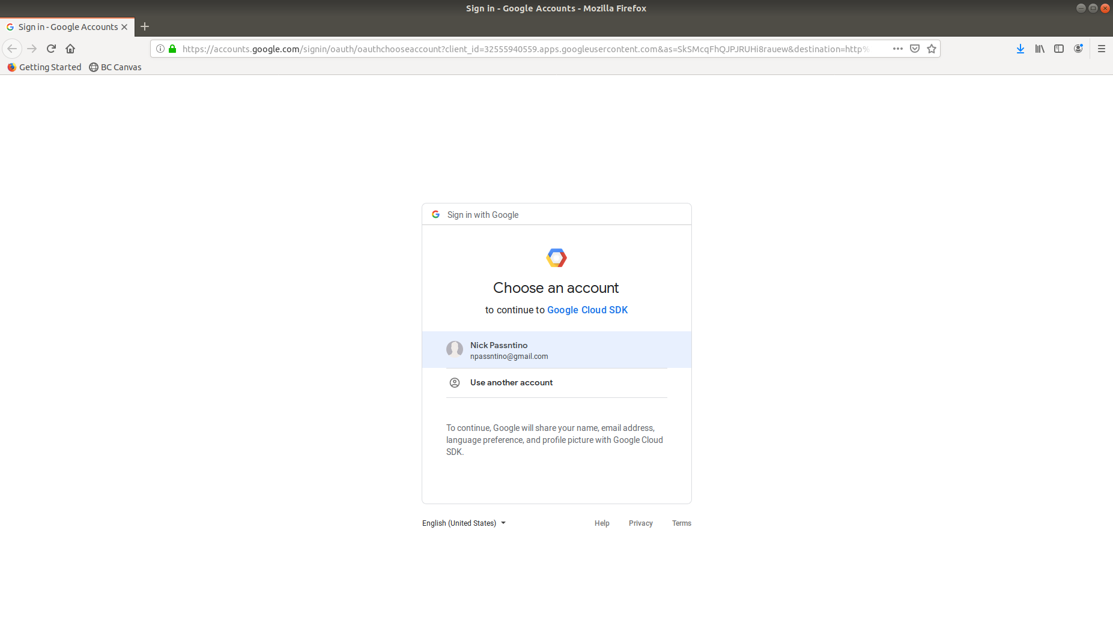
Log into GCP using a Gmail account

Slide 17
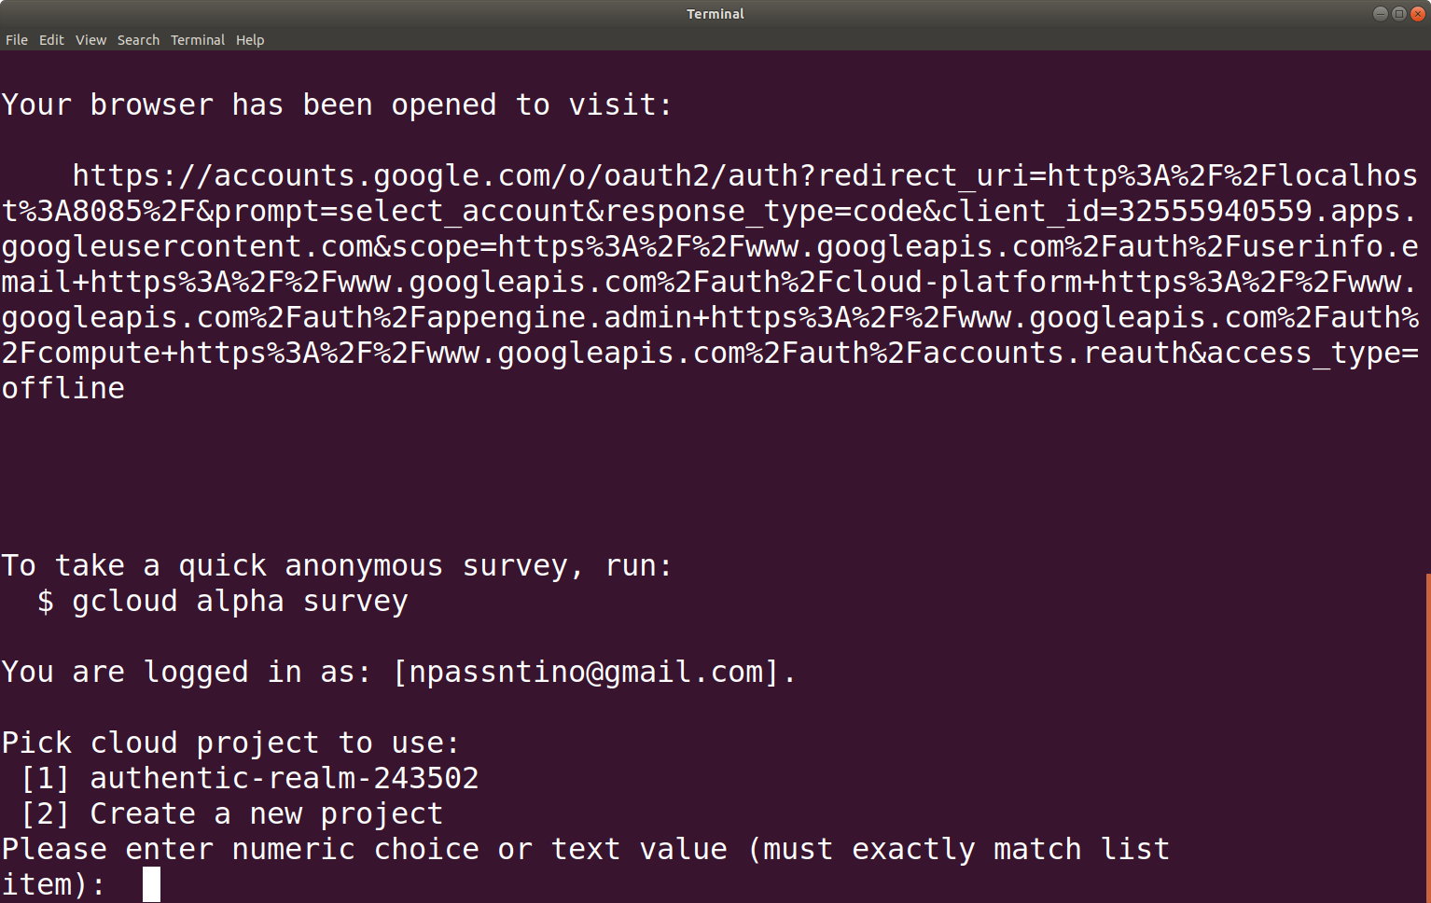
Select a project (or create a new one)

Slide 18
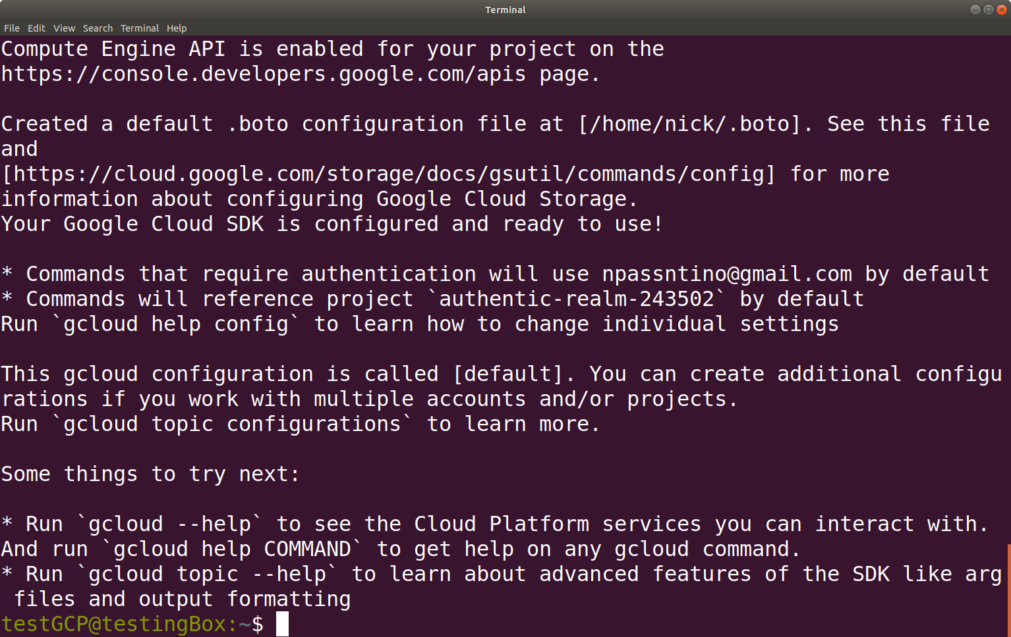
GCP is ready to use

